Slide 1

Optimize Azure Synapse SQL Pools
{ |  | }
 | Azure Synapse SQL Pools

Slide 2
Optimizing Caching
Module 6

Slide 3
Learning Units covered in this Module
Lesson 1: Result Set Caching
Lesson 2: Replicated Table Caching
Lesson 3: Adaptive caching
Notes:
Lesson 2: Performance improvements to expect when scaling
Different types of queries improve differently
Lesson 3: How can pause/resume be affected in duration
Lesson 4: How replicated tables are affected during scaling

Slide 4
Lesson 1: Result Set Caching

Slide 5

Objectives
After completing this lesson, you will be able to:
Understand the following topics:
Understand result set caching and its benefits
Types of table that can benefit from replicated table caching
Managing result set caching, including rebuilding cache

Slide 6
Result Set Caching
When Result Set Caching is enabled:
SQL automatically caches query results in the user database for repetitive use.
With subsequent executions, results come directly from the persisted cache.
No recomputation
Doesn’t use concurrency slots
Reduce compute resource usage
Notes:
When result set caching is enabled, Synapse SQL automatically caches query results in the user database for repetitive use.
This allows subsequent query executions to get results directly from the persisted cache so recomputation is not needed.
Result set caching improves query performance and reduces compute resource usage.
In addition, queries returning cached results set do not use any concurrency slots and thus do not count against existing concurrency limits.
For security, users can only access the cached results if they have the same data access permissions as the users creating the cached results.
HOWEVER – subsequent queries must be an exact match, a change in any query parameter(s) will incur a cache miss

Slide 7
Result Set Caching
Enabling/Disabling
Enable/Disable at the database
ALTER DATABASE <DATABASENAME> SET RESULT_SET_CACHING {ON | OFF}
Enable/Disable for the current session
SET RESULT_SET_CACHING { ON | OFF };
Notes:
Should this be Mbps? Also, spell out at first instance. Similarly, check if in the last sentence in this para, if it should be Gbps

Slide 8
Result Set Caching
Queries are NOT cached when they…
Use non-deterministic functions
Use user defined functions
Use tables with row level security or column level security enabled
Return data with row size larger than 64KB
Return large data in size (>10GB)
Notes:
What's not cached
Once result set caching is turned ON for a database, results are cached for all queries until the cache is full, except for these queries:
Queries using non-deterministic functions such as DateTime.Now()
Queries using user defined functions
Queries using tables with row level security or column level security enabled
Queries returning data with row size larger than 64KB
Queries returning large data in size (>10GB)
The operations to create result set cache and retrieve data from the cache happen on the control node of a Synapse SQL pool instance. When result set caching is turned ON, running queries that return large result set (for example, >1GB) can cause high throttling on the control node and slow down the overall query response on the instance. Those queries are commonly used during data exploration or ETL operations. To avoid stressing the control node and cause performance issue, users should turn OFF result set caching on the database before running those types of queries.

Slide 9
Result Set Caching
Cached result set is reused when…
User running the query has access to all the tables referenced in the query.
There is an exact match between the new query and the previous query that generated the result set cache.
There is no data or schema changes in the tables where the cached result set was generated from.
Notes:
When cached results are used
Cached result set is reused for a query if all of the following requirements are all met:
The user who's running the query has access to all the tables referenced in the query.
There is an exact match between the new query and the previous query that generated the result set cache.
There is no data or schema changes in the tables where the cached result set was generated from.

Slide 10
Dynamic Management Views
DMV | Log Analytics where Category = ‘<catagorybelow>’
Sys.dm_pdw_exec_requests | ExecRequests
Sys.dm_pdw_request_steps | RequestSteps
Sys.dm_pdw_dms_workers | DmsWorkers
Sys.dm_pdw_sql_requests | SqlRequests
Notes:
Run this query for the time taken by result set caching operations for a query.
Here is an example output for a query executed with result set caching enabled.

Slide 11
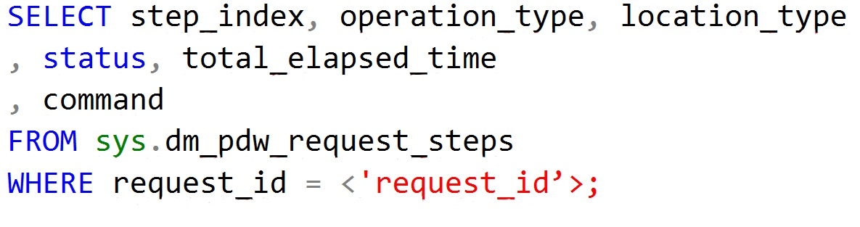
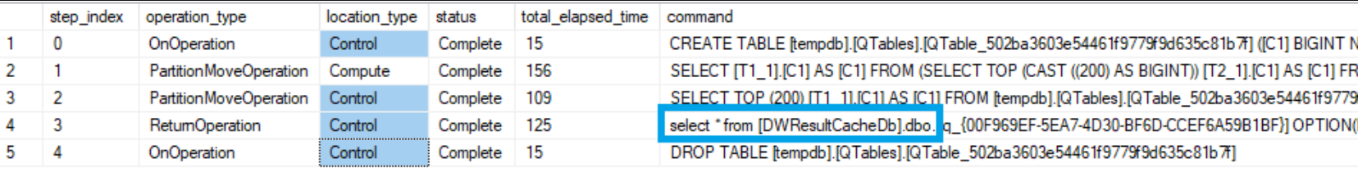
Result Set Caching
Monitoring
Notes:
Run this query for the time taken by result set caching operations for a query.
Here is an example output for a query executed with result set caching enabled.

Slide 12
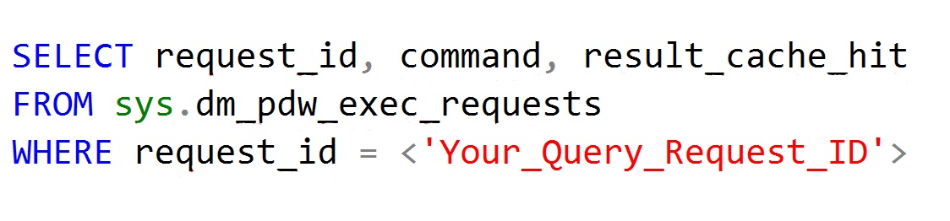
Result Set Caching
Monitoring
Result_cache_hit returns 1 for a cache hit and 0 for a cache miss.
Notes:
Run this command to check if a query was executed with a result cache hit or miss. The result_cache_hit column returns 1 for cache hit, 0 for cache miss, and negative values for reasons why result set caching was not used. Check sys.dm_pdw_exec_requests for details.

Slide 13
Result Set Caching
Space Used
Check the space used by Result Set Caching
DBCC SHOWRESULTCACHESPACEUSED
Requires VIEW SERVER STATE permission

Slide 14
Result Set Caching
Cleanup
Clear the Result Set Cache
DBCC DROPRESULTSETCACHE
Requires DB_OWNER permissions
Removes all result set cache entries from the SQL Pool
Notes:
Users can manually empty the entire result set cache by using one of these options:
Turn OFF the result set cache feature for the database
Run DBCC DROPRESULTSETCACHE while connected to the database
Pausing a database won't empty cached result set.

Slide 15
Result Set Caching
Management
The maximum size of result set cache is 1 TB per database
The cache eviction is managed by Synapse SQL automatically
Every 48 hours if the result set hasn't been used or has been invalidated.
When the result set cache approaches the maximum size.
Notes:
Manage cached results
The maximum size of result set cache is 1 TB per database. The cached results are automatically invalidated when the underlying query data change.
The cache eviction is managed by Synapse SQL automatically following this schedule:
Every 48 hours if the result set hasn't been used or has been invalidated.
When the result set cache approaches the maximum size.

Slide 16
Lesson 2: Replicated Table Caching

Slide 17
Objectives
After completing this lesson, you will be able to:
Understand the following topics:
Understand replicated tables and replicated caching
Benefits of replicated table caching
Best practices for replicated tables

Slide 18
Replicated Tables
Full copy on each compute node
Best when < 2GB compressed
Static Tables
DBCC PDW_SHOWSPACEUSED(‘TableName’)
Used in joins that would require data movement
Notes:
What is a replicated table?
A replicated table has a full copy of the table accessible on each Compute node. Replicating a table removes the need to transfer data among Compute nodes before a join or aggregation. Since the table has multiple copies, replicated tables work best when the table size is less than 2 GB compressed. 2 GB is not a hard limit. If the data is static and does not change, you can replicate larger tables.

Slide 19
Replicated Tables
Should a table be replicated? It depends…
Frequent insert/update/delete operations
Frequent scaling of the database
Wide table with few columns accessed
…Consider a different distribution.
Notes:
Replicated tables may not yield the best query performance when:
The table has frequent insert, update, and delete operations. The data manipulation language (DML) operations require a rebuild of the replicated table. Rebuilding frequently can cause slower performance.
The SQL pool database is scaled frequently. Scaling a SQL pool database changes the number of Compute nodes, which incurs rebuilding the replicated table.
The table has a large number of columns, but data operations typically access only a small number of columns. In this scenario, instead of replicating the entire table, it might be more effective to distribute the table, and then create an index on the frequently accessed columns. When a query requires data movement, SQL pool only moves data for the requested columns.

Slide 20
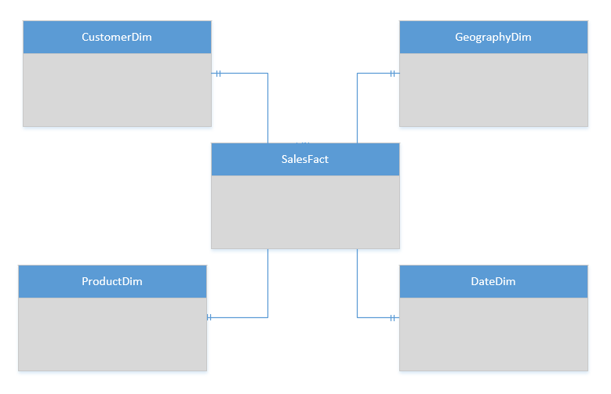
Replicated Table Scenarios
Scenarios to consider using Replicated tables:
Star schema reporting
Dimensions – descriptive entities about fact data
ELT master data, common domain data used during transaction loading
Tables 2GB or less in size
Notes:
https://docs.microsoft.com/en-us/azure/synapse-analytics/sql-data-warehouse/design-guidance-for-replicated-tables
Replicated tables work well for dimension tables in a star schema. Dimension tables are typically joined to fact tables which are distributed differently than the dimension table. Dimensions are usually of a size that makes it feasible to store and maintain multiple copies. Dimensions store descriptive data that changes slowly, such as customer name and address, and product details. The slowly changing nature of the data leads to less maintenance of the replicated table.
Consider using a replicated table when:
The table size on disk is less than 2 GB, regardless of the number of rows. To find the size of a table, you can use the DBCC PDW_SHOWSPACEUSED command: DBCC PDW_SHOWSPACEUSED('ReplTableCandidate').
The table is used in joins that would otherwise require data movement. When joining tables that are not distributed on the same column, such as a hash-distributed table to a round-robin table, data movement is required to complete the query. If one of the tables is small, consider a replicated table. We recommend using replicated tables instead of round-robin tables in most cases. To view data movement operations in query plans, use sys.dm_pdw_request_steps. The BroadcastMoveOperation is the typical data movement operation that can be eliminated by using a replicated table.

Slide 21
T-SQL: Create a Replicated table
CREATE TABLE dbo.DimCustomer
( CustomerKey int NOT NULL
, GeographyKey int NULL
, CustomerAlternateKey nvarchar(15) NOT NULL
, Title nvarchar(8) NULL
, FirstName nvarchar(50) NULL
, LastName nvarchar(50) NULL
, BirthDate date NULL
, Gender nvarchar(1) NULL
, EmailAddress nvarchar(50) NULL
, YearlyIncome money NULL
, DateFirstPurchase date NULL
)
WITH
( CLUSTERED COLUMNSTORE INDEX
, DISTRIBUTION = REPLICATED
)
Notes:
Simple example of a replicated table creation.
We have not accounted for –
Data loads to the table – best with round robin, heap
The size of the table – will the table be 2GB or less in size?

Slide 22

Replicated Table Caching
Compute Node 1
RR Table
RR Table
RR Table
RR Table
Cache Build Request
Replication Cache Manager
Repl Table
Distribution_1
Distribution_2
Distribution_3
Distribution_4
Compute Node 2
CREATE
CREATE
SELECT
SELECT
UPDATE
UPDATE
RR Table
RR Table
RR Table
RR Table
Repl Table
Distribution_5
Distribution_6
Distribution_7
Distribution_8
Notes:
WHY A CACHE? – TO ACHIEVE ELASTICITY
The replicated table cache is no longer built as a step in the query plan during the runtime of the query. A select against an un-cached replicated table submits a request to build the cache, to the replication cache manager, asynchronously and is resolved immediately against the round robin table.
Further calls to access the table will also be resolved against the RR table, until the caching operation is completed.
The cache manager will execute 2 caching operations simultaneously, any further requests are queued.

Slide 23
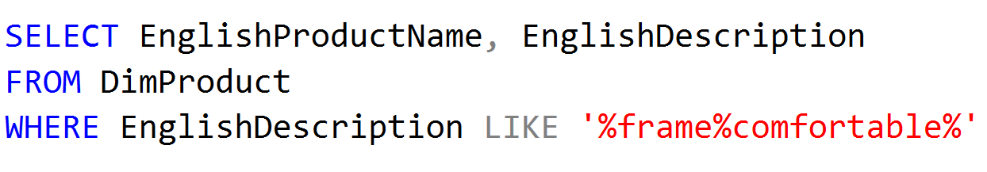
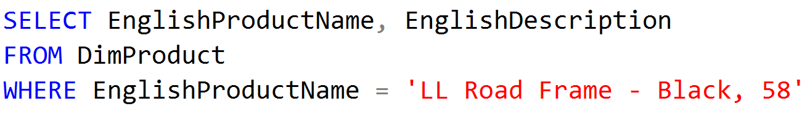
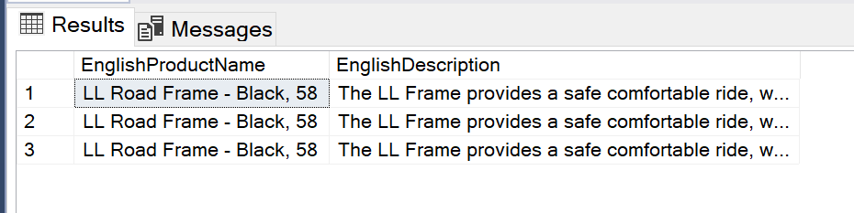
Replicated Table Caching
Queries
Replicated tables perform best for predominant query patterns with Simple predicates:
Notes:
Use replicated tables with simple query predicates
Before you choose to distribute or replicate a table, think about the types of queries you plan to run against the table. Whenever possible,
Use replicated tables for queries with simple query predicates, such as equality or inequality.
Use distributed tables for queries with complex query predicates, such as LIKE or NOT LIKE.
CPU-intensive queries perform best when the work is distributed across all of the Compute nodes. For example, queries that run computations on each row of a table perform better on distributed tables than replicated tables. Since a replicated table is stored in full on each Compute node, a CPU-intensive query against a replicated table runs against the entire table on every Compute node. The extra computation can slow query performance.

Slide 24
Replicated Table Caching
Round Robin Tables vs. Replicated Tables
Round-Robin Table
Data distributed in a round-robin fashion across all compute nodes
Join operation will copy full table to each computer node
Broadcast move operation
Replicated Table
Full copy of the table on each compute node
No expensive data movement between the compute nodes
Notes:
Query performance example for round-robin versus replicated
A replicated table does not require any data movement for joins because the entire table is already present on each Compute node.
If the dimension tables are round-robin distributed, a join copies the dimension table in full to each Compute node.
To move the data, the query plan contains an operation called BroadcastMoveOperation.
This type of data movement operation slows query performance and is eliminated by using replicated tables.
To view query plan steps, use the sys.dm_pdw_request_steps system catalog view.

Slide 25
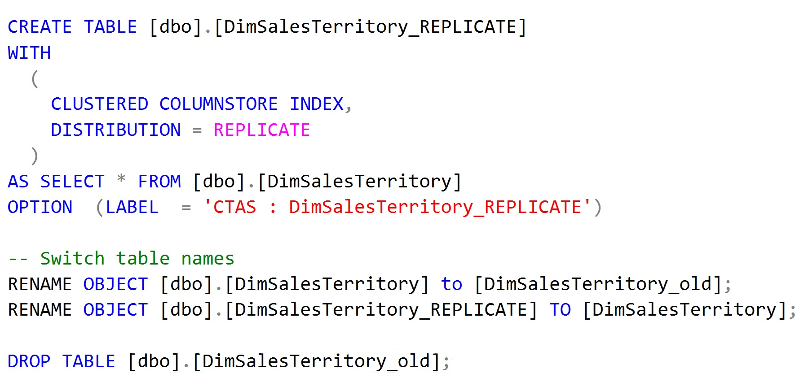
Replicated Table Caching
Convert Round Robin Tables to Replicates Tables
Notes:
Query performance example for round-robin versus replicated
A replicated table does not require any data movement for joins because the entire table is already present on each Compute node.
If the dimension tables are round-robin distributed, a join copies the dimension table in full to each Compute node.
To move the data, the query plan contains an operation called BroadcastMoveOperation.
This type of data movement operation slows query performance and is eliminated by using replicated tables.
To view query plan steps, use the sys.dm_pdw_request_steps system catalog view.

Slide 26

Replicated Table Caching
Rebuilds are triggered by the first query against the replicated table after:
Data is loaded or modified
Database scaling
Table definition is updated
Rebuilds are not required/triggered after
Pause / Resume operation
Rebuilding replicated tables
Rebuilds are triggered with the first query.
Notes:
Performance considerations for modifying replicated tables
SQL pool implements a replicated table by maintaining a master version of the table. It copies the master version to the first distribution database on each Compute node. When there is a change, the master version is updated first, then the tables on each Compute node are rebuilt.
A rebuild of a replicated table includes copying the table to each Compute node and then building the indexes.
For example, a replicated table on a DW2000c has 5 copies of the data.
A master copy and a full copy on each Compute node.
All data is stored in distribution databases. SQL pool uses this model to support faster data modification statements and flexible scaling operations.
Asynchronous rebuilds are triggered by the first query against the replicated table after:
Data is loaded or modified
The Synapse SQL instance is scaled to a different level
Table definition is updated
Rebuilds are not required after:
Pause operation
Resume operation
The rebuild does not happen immediately after data is modified. Instead, the rebuild is triggered the first time a query selects from the table. The query that triggered the rebuild reads immediately from the master version of the table while the data is asynchronously copied to each Compute node. Until the data copy is complete, subsequent queries will continue to use the master version of the table. If any activity happens against the replicated table that forces another rebuild, the data copy is invalidated and the next select statement will trigger data to be copied again.
Use indexes conservatively
Standard indexing practices apply to replicated tables. SQL pool rebuilds each replicated table index as part of the rebuild. Only use indexes when the performance gain outweighs the cost of rebuilding the indexes.

Slide 27
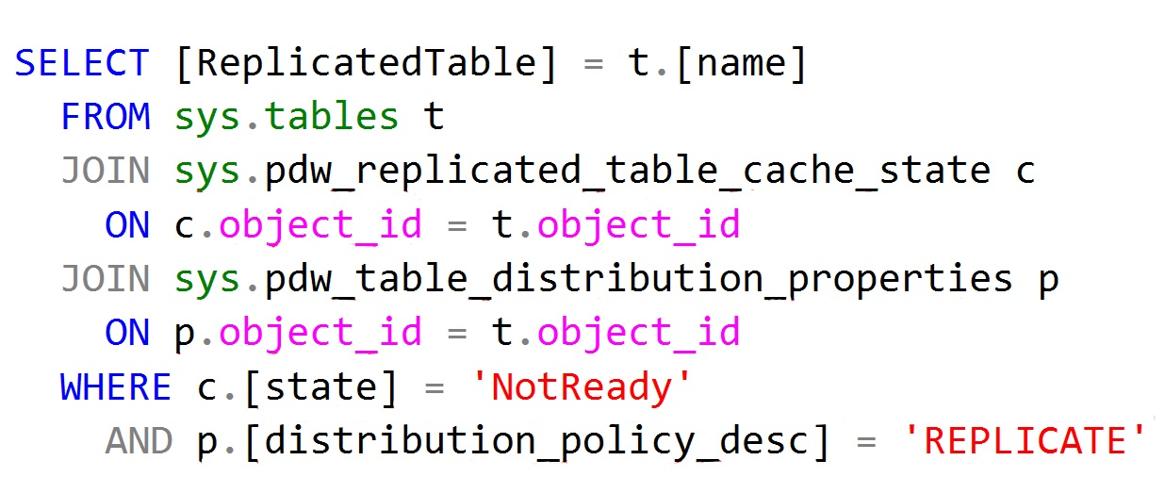
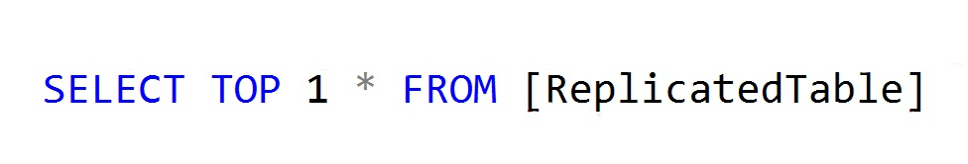
Replicated Table Caching
Rebuild replicated table after batch load
Check replicated tables that need to be rebuilt
Trigger a rebuild
Notes:
Rebuild a replicated table after a batch load
To ensure consistent query execution times, consider forcing the build of the replicated tables after a batch load. Otherwise, the first query will still use data movement to complete the query.
This query uses the sys.pdw_replicated_table_cache_state DMV to list the replicated tables that have been modified, but not rebuilt.

Slide 28


Replicated Table Caching
Batch loads and Rebuilds
Load FactSales from source 1.
Select top 1 * from FactSales (rebuild 1).
Load FactSales from source 2.
Select top 1 * from FactSales (rebuild 2).
Load FactSales from source 3.
Select top 1 * from FactSales (rebuild 3).
Load FactSales from source 4.
Select top 1 * from FactSales (rebuild 4).
Load FactSales from source 1.
Load FactSales from source 2.
Load FactSales from source 3.
Load FactSales from source 4.
Select top 1 * from FactSales (rebuild 1).
Notes:
Batch data load
When loading data into replicated tables, try to minimize rebuilds by batching loads together. Perform all the batched loads before running select statements.
For example, this load pattern loads data from four sources and invokes four rebuilds.
Loading FactSales with select operations after each load to rebuild the table -
Load FactSales from source 1.
Select top 1 * from FactSales (rebuild 1).
Load FactSales from source 2.
Select top 1 * from FactSales (rebuild 2).
Load FactSales from source 3.
Select top 1 * from FactSales (rebuild 3).
Load FactSales from source 4.
Select top 1 * from FactSales (rebuild 4).
Load FactSales from all four sources and then have one select operation -
Load FactSales from source 1.
Load FactSales from source 2.
Load FactSales from source 3.
Load FactSales from source 4.
Select top 1 * from FactSales (rebuild 1).
https://docs.microsoft.com/en-us/azure/synapse-analytics/sql-data-warehouse/design-guidance-for-replicated-tables#rebuild-a-replicated-table-after-a-batch-load

Slide 29
Lesson 3: Adaptive Cache

Slide 30
Objectives
After completing this lesson, you will be able to:
Understand the following topics:
Understand adaptive caching
Benefits of adaptive caching
Managing adaptive cache

Slide 31
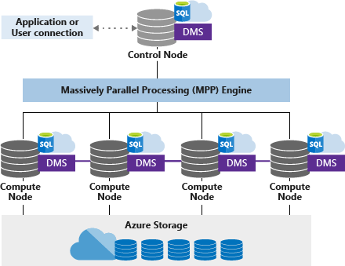
Adaptive Cache
Data cached based on workload characteristics
Non-Volatile Memory Express (NVMe)
I/O - NVMe SSDs > SATA SSDs/hard drives
Notes:
https://azure.microsoft.com/en-us/blog/adaptive-caching-powers-azure-sql-data-warehouse-performance-gains/
One of the recent hardware innovations becoming widely available are NVM Express (NVMe) solid-state drive (SSD) devices.
NVMe SSDs offer significantly more I/O bandwidth than SATA SSDs or hard drives.
A typical single NVMe device used in Azure, generally offers up to 2GB/sec of local I/O bandwidth, with multiple devices available per physical host, resulting in bandwidth previously reserved only to very high-end storage systems.
Azure Synapse SQL Pools Compute Optimized tier fully takes advantage of NVMe devices through adaptive caching of recently used data on NVMe. With this breakthrough on customer workloads, we have observed up to five times the improvement in query performance, compared with the first generation of Azure SQL DW and some workloads improved even more.
Before we delve into details, I’d like to describe on how SQL Server implements industry leading columnar storage, which is the default storage type used in Azure SQL DW.
Columnstore divides table rows into 1 million row units called rowgroups and compresses each column within the row group.
A variety of compression techniques are used, such as dictionaries, bit-packing, and run-length encoding.
When data is scanned, only required columns are read into memory.
Compression and columnar oriented storage results in significant reduction of I/O requirements.
In addition, in many cases SQL Server engine operates directly over compressed data, taking full advantage of vectorized CPU extensions such as AVX.
The combination of both techniques often results in up to 10 times the improvement in query speeds over row-stores.

Slide 32
Adaptive Cache
Cores
Memory
Control
SSD TempDB
Cores
Memory
Cores
Memory
Cores
Memory
NVMe SSD
NVMe SSD
NVMe SSD
Compute
Cache
TempDB
Cache
TempDB
Cache
TempDB
Data
Remote storage
Log
Notes:
In this slide you need to be focus on the Control node and Compute node components.
The animation explains how the storage is queried and data goes to the Cache to minimize the request latency.
The first time you query data, the data goes from the Storage to the cache. The other request occurrences, the data will remain in the Cache.
The cache is also used for the replicated tables. In the background the Replicated table is stored as a Round-robin Distributed table. When you scale or resume, the replicated table are not stored in the cache. The data will reside in the cache the first time it will be requested.
One of the biggest bottlenecks and pain points for delivering high performance is disk access.
This holds especially true in cloud computing where the distance from the compute layer to the storage layer can potentially vary, leading to suboptimal query performance.
Azure Synapse SQL Pools Compute Optimized delivers built-in adaptive caching that automatically caches data based on workload characteristics and query access patterns.
Combining in-memory and disk-deployed caches, SQL Pool automatically and transparently moves frequently accessed data across various caching tiers.
This caching strategy leads to faster data access and ultimately faster query performances.
Non-Volatile Memory / Flash Memory hosting Cache and tempdb
NVM Express reduces I/O overhead and brings various performance improvements in comparison to previous logical-device interfaces, including multiple, long command queues, and reduced latency.
Continue explaining the different layers by being focus on the NVMe SSD containing the cache and the Tempdb,

Slide 33
Automated Tiering Of Storage Layers
Node
Capacity
Access
Time
Memory
Adaptive Cache
Remote Storage
hot data
300GB+
70 ns
1.5TB
warm data
20 µs
∞
100 ms
cold data
Notes:
Memory – consumed by workload; fastest response time – 70 nanoseconds; 300GB+ per node;
Between the fastest and slowest storage layers we have the adaptive cache -
Adaptive Cache – 1.5TB per node; faster than remote storage – 20 microsecond response time;
Remote storage – the slowest storage; 100 millisecond response time; typically for data that is not frequently accessed. Unlimited storage.

Slide 34
Adaptive cache miss (cold scan)
SELECT SUM(TotalCost) FROM FactSales_CCI
Adaptive cache hit (hot scan)
SELECT SUM(TotalCost) FROM FactSales_CCI
Columnstore Object Pool
Memory
Hit?
Adaptive
Cache
Local NVMe SSD
Hit?
Remote storage
Remote Read
Notes:
adaptive cache miss cold scan
we have a simple select with a sum operation
is the query in the adaptive cache?
not currently in the adaptive cache; this time we have to read from remote storage
query result added to adaptive cache
result returned to the sql pool memory
query result returned to the end user
adaptive cache hit hot scan
we have a simple select with a sum operation - same query from before
result returned from memory

Slide 35
Pause or Scale
Clearing the adaptive cache
DBCC DROPCLEANBUFFERS (ALL)
Columnstore Object Pool
Memory
Update costing info
Adaptive
Cache
Local NVMe SSD
Remote storage
Notes:
clearing the adaptive cache
memory is cleared out, but adaptive cache remains
cost info is updated
clearing the adaptive cache - pausing/scaling
adaptive cache is cleared
cost info is updated

Slide 36
Adaptive cache miss (full cache, cold scan)
SELECT SUM(TotalCost)
FROM FactSales_CCI
SELECT SUM(TotalCost)
FROM FactSales_CCI
Columnstore Object Pool
Memory
Hit?
Full Adaptive
Cache
Local NVMe SSD
Hit?
Remote storage
Remote Read
Notes:
adaptive cache miss - full cache, cold scan
we have a simple select with a sum operation - same query from before
is the query in memory? no
is the query in adaptive cache? no
we have to do a remote read - older query is dropped from the adaptive cache to make room for our current query

Slide 37
Adaptive Cache - Loading Guidance
Use ELT where possible
Leverage HEAP for initial load
Faster load time
Prevent cache population/eviction
Assign appropriate resource class for optimal CCI compression
Notes:
ELT – extract, load, transform; with synapse, leverage the MPP environment to perform the transfomations.
Load data to a heap; once the data is loaded, it can then be CTAS’d into hash distributed or replicated tables
Loading data to CCI tables requires a larger resource class for optimal CCI compression and to avoid the consequences of poorly formed segments that result from loading data with memory pressure.

Slide 38
CREATE TABLE TableCCI
WITH
(
CLUSTERED COLUMNSTORE INDEX,
DISTRIBUTION = ROUND_ROBIN
)
AS SELECT * FROM externalTable;
CREATE TABLE TableHeap
WITH
(
HEAP,
DISTRIBUTION = ROUND_ROBIN
)
AS SELECT * FROM externalTable;
SELECT SUM(TotalCost)
FROM TableCCI
SELECT SUM(TotalCost)
FROM TableHeap
SELECT SUM(TotalCost)
FROM #TableHeap
CREATE TABLE #Table_HEAP
WITH
(
HEAP,
DISTRIBUTION = ROUND_ROBIN
)
AS SELECT * FROM externalTable;
Loading Data
Columnstore Object Pool
Buffer
Pool
Memory
Adaptive
Cache
Tempdb
Local NVMe SSD
Remote storage
External storage
ExternalFiles
Notes:
Loading Data
We have data we have loaded into external files
How can we load this data into the sql pool?
1. create CCI, round robin table - data loaded to remote storage
2. we can query the table - adaptive cache, memory
3. heap, round robin table - not using CCI;
4. query the heap - uses the buffer pool memory, not the columnstore object pool or adaptive cache
5. heap, round robin temp table - not using CCI;
6. query the temp table - uses the buffer pool memory, not the columnstore object pool or adaptive cache

Slide 39
Sizing the Cache
DWU | Memory (GB) | Tempdb (TB) | Cache (TB)
1000 | 720 | 4 | 3
1500 | 1080 | 5 | 4.5
2000 | 1440 | 7 | 6
2500 | 1800 | 9 | 7.5
3000 | 2160 | 11 | 9
5000 | 3600 | 18 | 15
6000 | 4320 | 22 | 18
7500 | 5400 | 27 | 22.5
10000 | 7200 | 36 | 30
15000 | 10800 | 54 | 45
30000 | 21600 | 108 | 90
Working set ~20%
1.5TB cache per DWU 500
EXEC sp_spaceused
This cache is per node
Notes:
Based on query performance and needs, scaling your sql pool DWU includes increases to memory, tempdb space and cache.
Modest increases until DWU3000c – after 3000, increases in memory and tempdb are more substantial.
Increases between DWU -
1000 – 1500 – mem doubles; 1TB tempdb; 1.5TB cache
1500 – 2000 – 360GB mem; 2TB tempdb; 1.5TB cache
2000 – 2500 – 360GB mem; 2TB tempdb; 1.5TB cache
2500 – 3000 – 360GB mem; 2TB tempdb; 1.5TB cache
3000 – 5000 – 1440 mem; 6TB tempdb; 6TB cache
5000 – 6000 – 720 mem; 4TB tempdb; 3TB cache
6000 – 7500 – 1080 mem; 5TB tempdb; 4.5TB cache
7500 – 10000 – 1800 mem; 9TB tempdb; 7.5TB cache
10000 – 15000 – 3600 mem; 18TB tempdb; 15TB cache
15000 – 30000 – 10800 mem; 54TB tempdb; 45TB cache

Slide 40
Knowledge Check
What are the steps to load tables in SQL Pool?
How can you update a set of records without an update statement?
When are queries not cached?
What is the recommended maximum size for replicated tables?
Notes:
1. Load data into blob storage; CTAS data from external files to heap tables; CTAS data from heap table into distributed table.
2. Partition switching
3. Queries using non-deterministic functions such as DateTime.Now()
Queries using user defined functions
Queries using tables with row level security or column level security enabled
Queries returning data with row size larger than 64KB
Queries returning large data in size (>10GB)
4. 2GB

Slide 41
Microsoft

